Slide 1
Monte Carlo Path Tracing
Implementation Issues

Slide 2
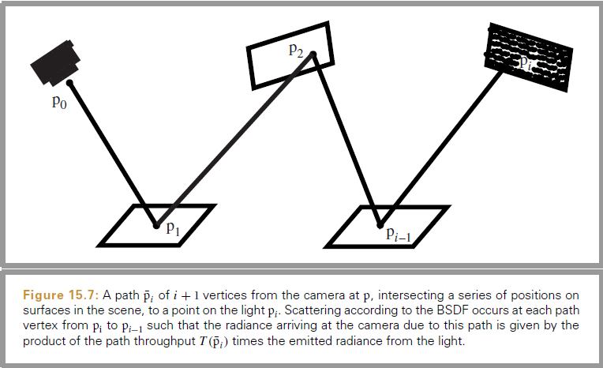
Path Tracing
See Pharr’s PBRT 2nd Ed. 15.3

Slide 3
DIRECT LIGHTING

Slide 4
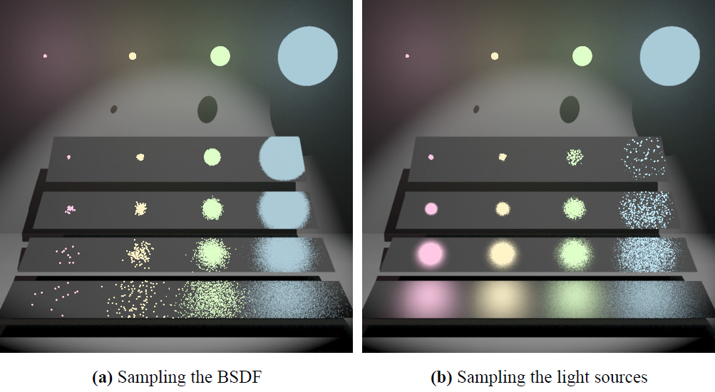
Source: Eric Veach, “Robust Monte Carlo Methods for Light Transport Simulation” Page 255, Figure 9.2.
Ph.D. Thesis, Stanford University

Slide 5
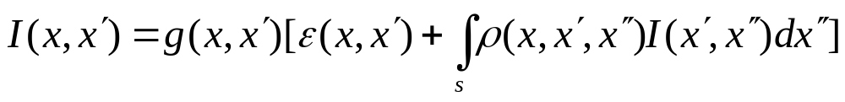
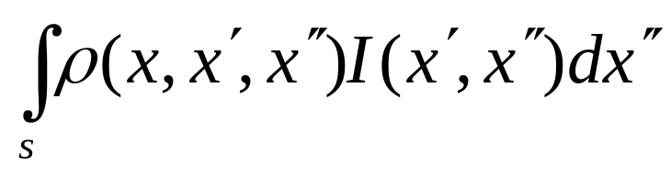
Integral of BRDF and Light
Rendering Equation (revisted)
Ignoring emitted light and occlusion, we still have an expensive integral:
Let f(Xi)=ρ (…) I (…) and evaluate its integral with Monte Carlo methods.

Slide 6
Exercise on Direct Lighting
How to compute the rendering equation for direct lighting?

Slide 7
Solving it by Ray Tracing?
No reflective ray is actually traced.
We compute the integral using the Phong lighting model.
The light source is simplified to a point light.

Slide 8
Solving it by Cook’s Ray Tracing?
Still no reflective ray is actually traced.
We compute the integral using the Phong lighting model.
But the light source is randomly sampled on the sphere.

Slide 9
Solving it by Path Tracing?
Many reflective rays are randomly chosen to compute the integral.
The ray may be chosen based on material or based on the light source.
If the reflective ray hits the light, its contribution I(x’, x”) is included.

Slide 10
Integral of BRDF and Light
Let f(Xi)=ρ (…) I (…) and evaluate its integral.
Case1: a diffuse surface and a few area lights
Case2: a specular surface and environment lighting
Uniform sampling isn’t efficient in both cases. Why?
ρ (…)
Ι (…)

Slide 11
RADIANCE & IRRADIANCE
Monte Carlo Path Tracing offers the insight to:

Slide 12
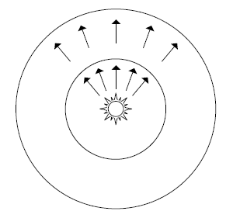
What Is Light Intensity?
The power of light source
  E.g., wattage of a light bulb.
  Flux (Φ) measured in watts (W) or joules/second
Does it change with distance?
  Another radiometric quantity needed here.
  Next slide: Irradiance (E)

Slide 13
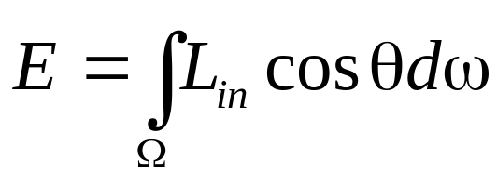
Radiance and Irradiance
Irradiance E
  Area density of flux.
  Measured in W/m²
  E = Φ / 4πr²
Radiance L
  Light energy density
  Measured in W/(sr-m²)
  Remains constant along rays
From Watt’s p.278

Slide 14
Exercise on Direct Lighting
Q1: How to compute
Q2: What is the contribution of the light spheres? Does it change with the distance?
Ans: Let’s assume the light sphere has radius r and its distance to the surface is d. The probability of the sample ray hits the sphere is proportional to r^2, but its intensity is 1/r^2. So the integral is the same (independent of r).
Now let’s look at d. When the r is fixed, whenever the sample ray hits the light sphere, its intensity should be the same. That means the radiance! (But the integral will decrease by 1/d^2.)

Slide 15
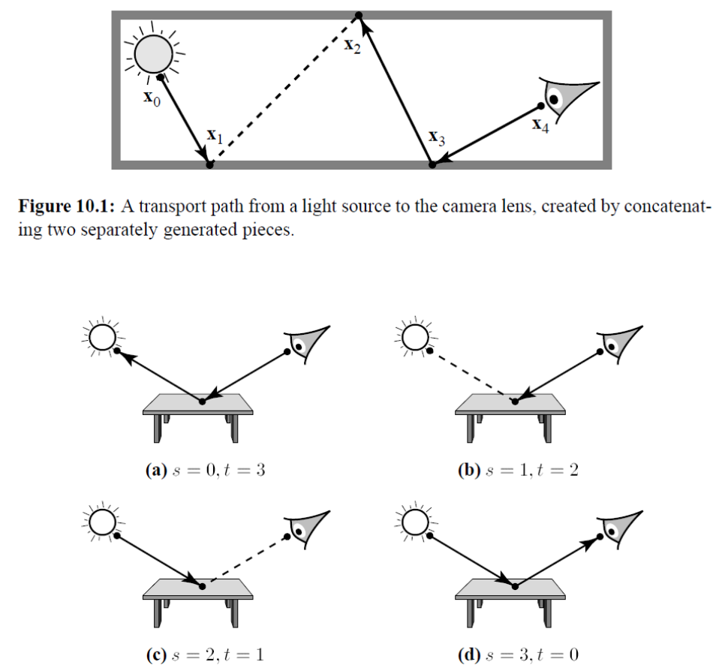
Bidirectional Path Tracing
Definition:
Source: Eric Veach’s Ph.D thesis, Ch.10

Slide 16
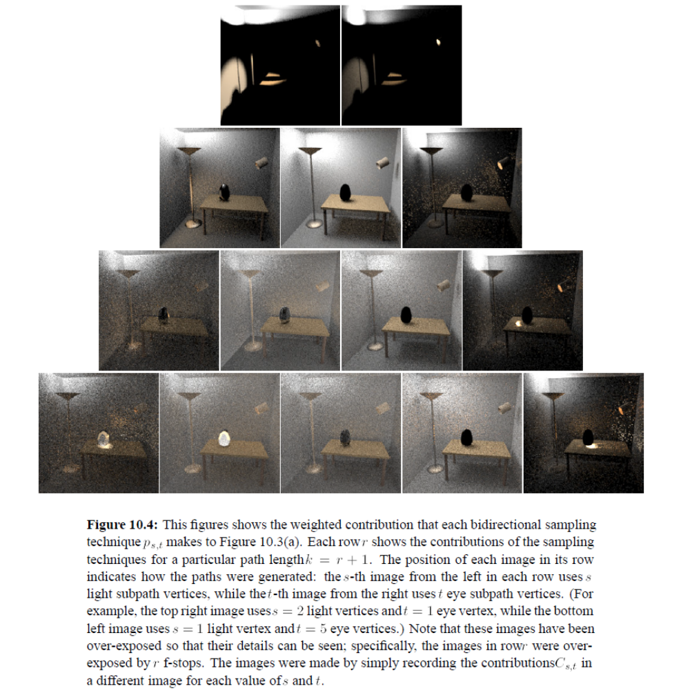
Source: Eric Veach’s
Ph.D thesis, Ch.10

Slide 17
The End

